Slide 1
Google play store
By: S Sandeep Sagar
Redg.no: 11713044

Slide 2
Introduction:
The Play Store apps data has enormous potential to drive app-making businesses to success. Actionable insights can be drawn for developers to work on and capture the Android market. The dataset is chosen from Kaggle. It is the web scraped data of 10k Play Store apps for analyzing the Android market. It consists of in total of 10841 rows and 13 columns.
The theme of a Google play store Apps is to design a representative dashboard to analyze the apps based on various app categories and other factors, which have a very important role to analyze the data.

Slide 3
Data fields:
App Name: Gives the name of the all apps
Category: Tells about which category that the app belongs to.
Rating: This tells the rating of the app given by the people.
Reviews: Gives the count of reviews of the people to the app.
Size: Can be determined the size of the app.
Installs: Tells the totals number of people installed that app.
Type: Whether the app is Free/Paid.
Price: Cost of particular app.
Content Rating: Tells the age limit of the people to download.
Last updated: App updated lastly.
Current version: Version of the app currently.
Android version: Supported android version.

Slide 4
Objectives:
According to that, I have done the some of the necessary analysis to analyze the data of the Google play store apps and the main Objectives are:
Top Trending apps in Google play store Apps with people reviews.
Percentage of Apps by Age-Category wise.
Top app-categories with the count of total apps in it.
Paid apps vs. Free apps
Finding top apps in category wise in google play store
Most un-used apps-categories in the google play store
Up-to-date apps in the google play store

Slide 5
Etl process:
ETL is defined as a process that extracts the data from different RDBMS source systems, then transforms the data (like applying calculations, concatenations, etc.) and finally loads the data into the Data Warehouse system. ETL full-form is Extract, Transform and Load.
As I taken dataset from the Kaggle, the data contained lot of duplicate values, Null values, and some repeated data along the dataset.
Therefore, by using Tableau Prep made my data clean and bring to proper data format and so, which is ready to analysis, the objectives of my dataset.

Slide 6
1. Top Trending apps in Google play store Apps with people reviews.

Slide 7
2. Percentage of Apps by Age-Category wise.

Slide 8
3. Top app-categories with the count of total apps in it.

Slide 9
4. Paid apps vs. Free apps

Slide 10
5. Finding top apps in category wise in google play store

Slide 11
6. Most un-used apps-categories in the google play store

Slide 12
7. Up-to-date apps in the google play store

Slide 13
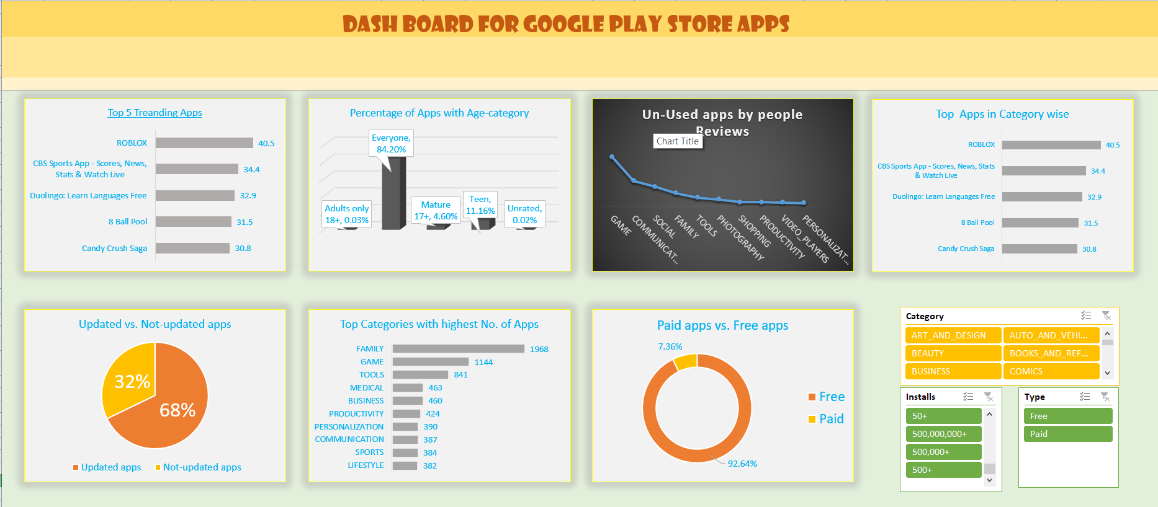
dashboard

Slide 14
references
Visited https://community.tableau.com/ to know how the operations done on tableau.
Referred MICROSOFT EXCEL 2016 BIBLE: THE COMPREHENSIVE TUTORIAL RESOURCE book regarding to how to do pivoting and how to do visualization for the particular dataset.

Slide 15
bibliography
Downloaded the Google play store dataset from www.kaggle.com.
I have downloaded tableau from www.tableau prep for students.com for cleaning of the data set.
https://medium.com/the-research-nest/data-science-tutorial-analysis-of-the-google-play-store-dataset-c720330d4903
https://nycdatascience.com/blog/student-works/web-scraping/analysis-of-apps-in-the-google-play-store/
https://www.pewinternet.org/2015/11/10/an-analysis-of-apps-in-the-google-play-store

Slide 16


